Slide 2




What is Design Pattern
Design pattern is a general reusable solution to a commonly occurring problem in software design.
A design pattern is not a finished design that can be transformed directly into code. It is a description or template for how to solve a problem that can be used in many different situations.

Slide 3

Why Design Patterns
•To design a new software system quickly and efficiently.
•To understand a existing software system.

Slide 4

Introduction
Promote reuse.
Use the experiences of software developers.
A shared library/lingo used by developers.
“Design patterns help a designer get a design right faster”.

Slide 5

Introduction
Based on the principles of object-oriented programming: abstraction, inheritance, polymorphism and association.
Are solutions to recurring problems to software design.
Are independent of the application domain.
Example – Variability of interfaces – the modeller view controller (MVC) pattern.

Slide 6

Object-Oriented Principles
Involves identifying:
Classes and objects
What to encapsulate
Association hierarchies
Inheritance hierarchies
Interface hierarchies
Object-oriented designs are evaluated in terms of how reusable, extensible and maintainable they are.

Slide 7

Types of Pattern – Catalog 1
Creational patterns
Focus on Object creation.
Focus on the best way to create instances of objects to promote flexibility, e.g. factory pattern.
Structural patterns
Focus on Relationship between entities.
Focus on the composition of classes and objects into larger structures, e.g. the adapter pattern.
Behavioural patterns
Focus on Communication between objects
Focus on the interaction between classes or objects,
e.g. the observer pattern.

Slide 8




Factory Pattern
 Factory pattern is one of the most used design patterns in Java. This type of design pattern comes under creational pattern as this pattern provides one of the best ways to create an object.
 In Factory pattern, we create object without exposing the creation logic to the client and refer to newly created object using a common interface.

Slide 9

Implementation
 We're going to create a Shape interface and concrete classes implementing the Shape interface. A factory class ShapeFactory is defined as a next step.
 FactoryPatternDemo, our demo class will
use ShapeFactory to get a Shape object. It will pass information (CIRCLE / RECTANGLE / SQUARE) to ShapeFactory to get the type of object it needs.

Slide 10

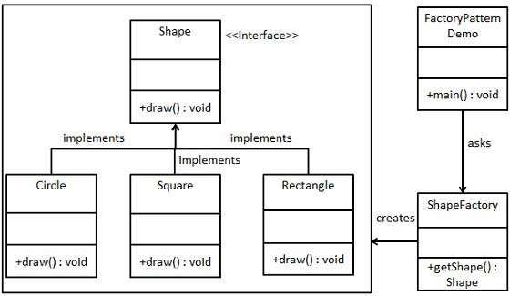
Implementation

Slide 11

Step 1
 Create an interface. (Shape.java)
public interface Shape {
void draw();
}

Slide 12

Step 2
 Create concrete classes implementing the same interface.
public class Rectangle implements Shape { @Override
public void draw() {
System.out.println("Inside Rectangle::draw() method.");
} }
public class Square implements Shape { @Override
public void draw() {
System.out.println("Inside Square::draw() method.");
} }
public class Circle implements Shape { @Override
public void draw() {
System.out.println("Inside Circle::draw() method.");
} }

Slide 13

Step 3
 Create a Factory to generate object of concrete class based on given information. (ShapeFactory.java)
public class ShapeFactory {
//use getShape method to get object of type shape
public Shape getShape(String shapeType){ if(shapeType == null){
return null;
}
if(shapeType.equalsIgnoreCase("CIRCLE")){
return new Circle();
} else if(shapeType.equalsIgnoreCase("RECTANGLE")){ return new Rectangle();
} else if(shapeType.equalsIgnoreCase("SQUARE")){
return new Square();
}
return null;
} }

Slide 14

Step 4
 Use Factory to get object of concrete class by passing information such as type. (FactoryPatternDemo.java)
public class FactoryPatternDemo {
public static void main(String[] args) { ShapeFactory shapeFactory = new ShapeFactory(); Shape shape1 = shapeFactory.getShape("CIRCLE"); shape1.draw();
Shape shape2 = shapeFactory.getShape("RECTANGLE"); shape2.draw();
Shape shape3 = shapeFactory.getShape("SQUARE"); shape3.draw();
}
}

Slide 15

Step 5
 Verify the output.
Inside Circle::draw() method. Inside Rectangle::draw() method. Inside Square::draw() method.

